Slide 1
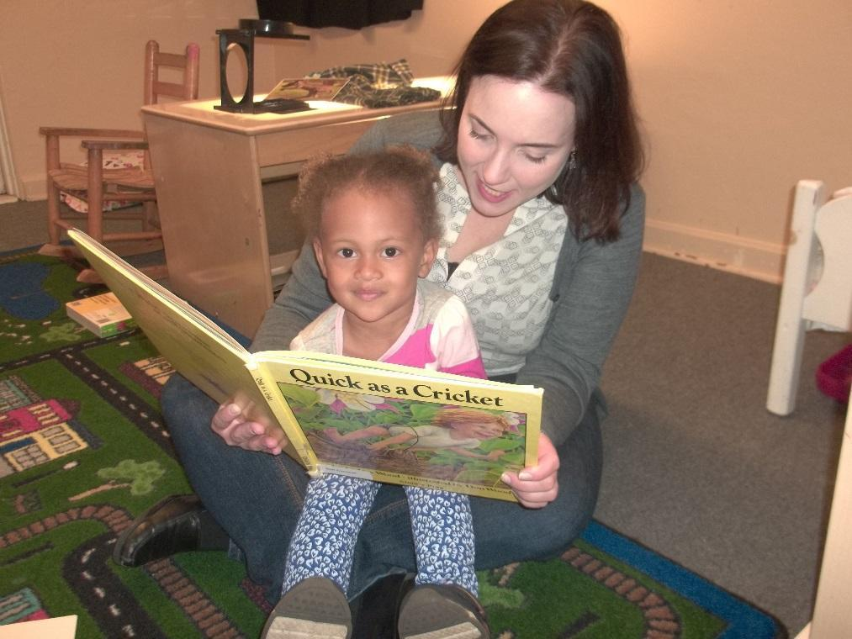
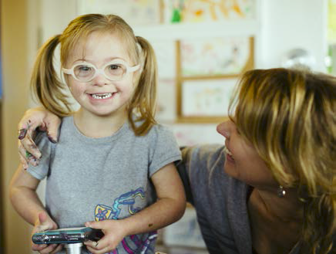
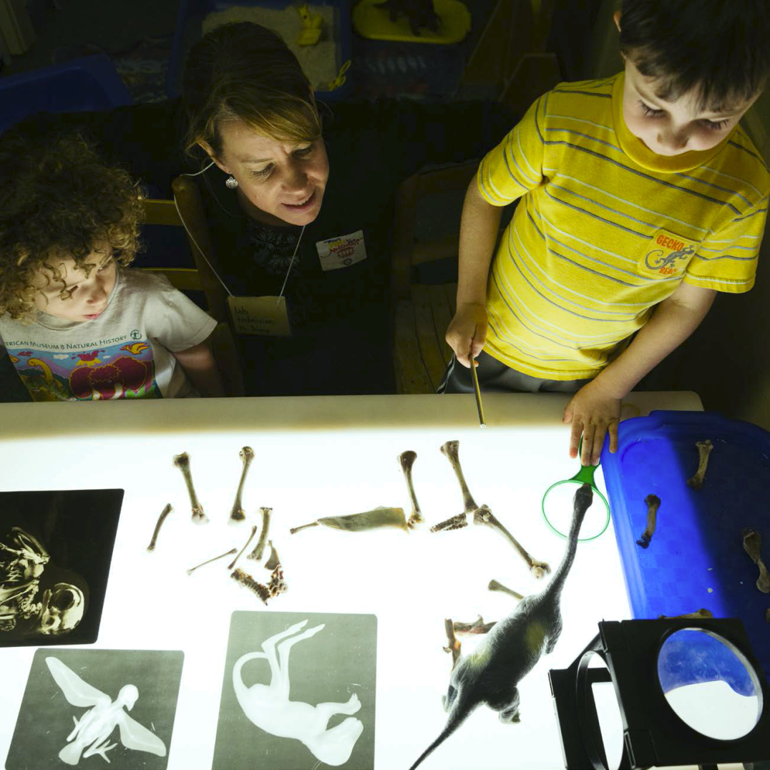

News You Can Use
About the Brain
Notes:
This slide could be up before we start. See options for titles. CMS: change pictures to Scott’s pictures from Flicker site.

Slide 2
News You Can Use about The Brain
Welcome & Introductions
Principles of Child Growth & Development
Hidden Milestones of Brain Development
Neuro Myths and Why They Matter
News
Wrap Up

Slide 3
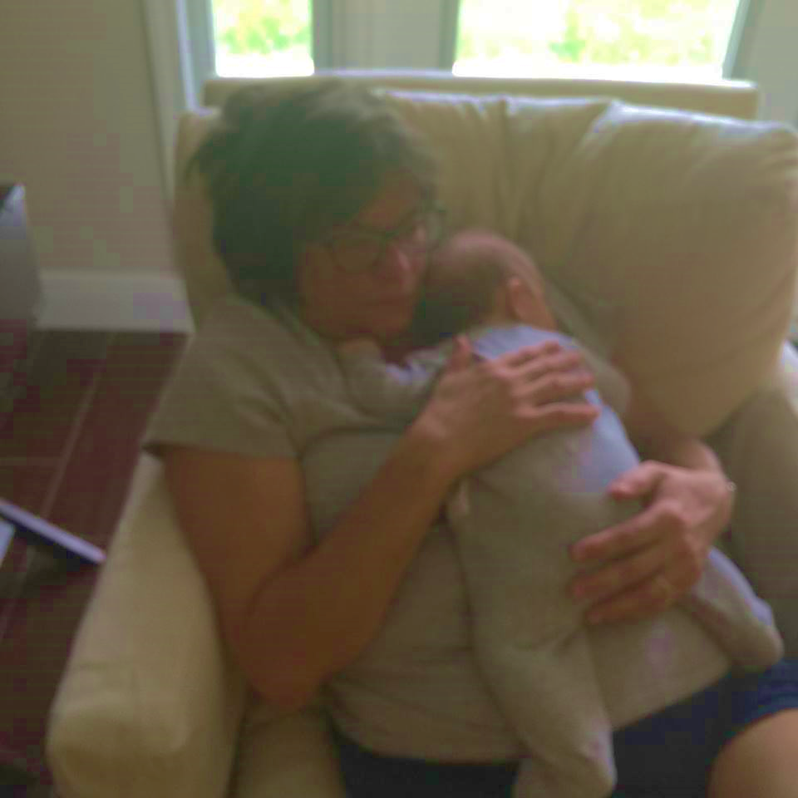
Welcome & Introductions
Sharon Carnahan, Ph.D.
Professor of Psychology
  M.A., Ph.D. UNC Chapel Hill
  Director, Rollins College Child Development & Student Research Center
  HOH, so raise your hand & speak up!

Slide 4
Class Rules
VOLUNTEER QUICKLY
RAISE YOUR HAND TO SPEAK
USE YOUR “but” and “bingo”
Teach it Out

Slide 5
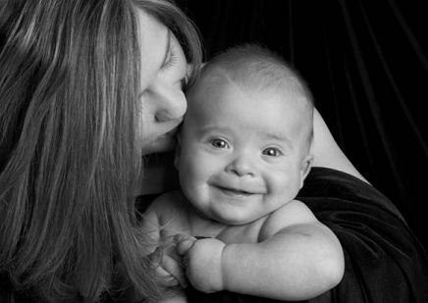

Stand Up!
Hello
5+ years experience?
Taken a “brain based learning” course?
Parent?
Know a special food for pregnant women?
Know a song in English?
Know what MYELIN is?

Slide 6
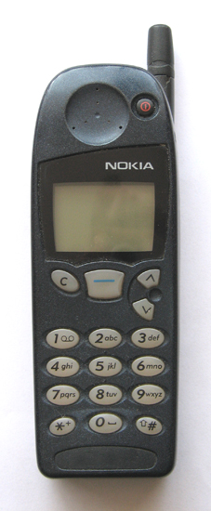
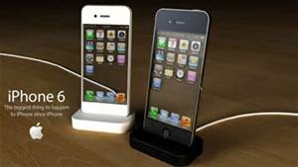
2000
Year of publication of “From Neurons to Neighborhoods”
2014
“Neuroscience and Education: Myths and Messages”

Slide 7
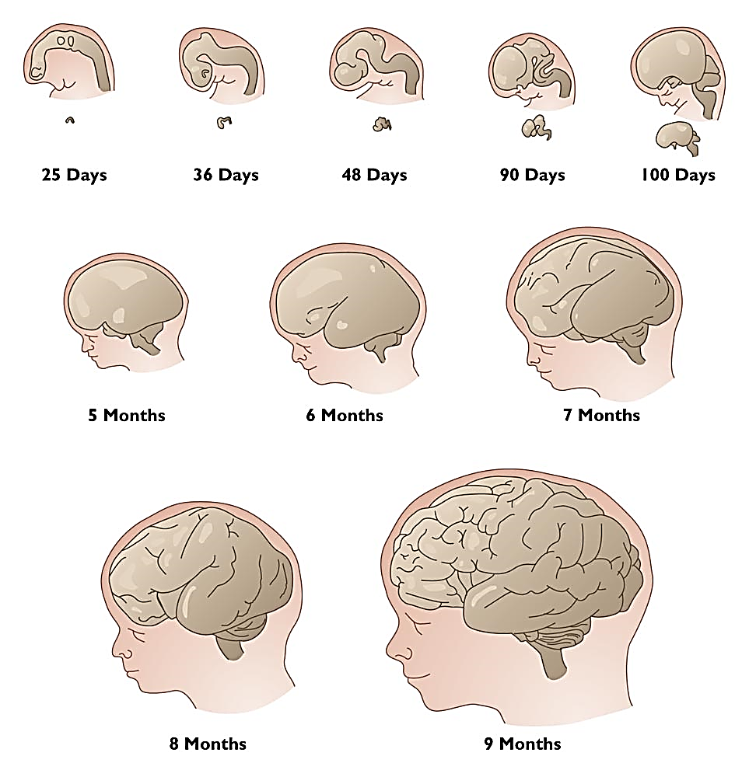
1. The Brain at Birth is a Work in Progress,
With 9 Months of Past Experience Built In
Prenatal food links to early learning
Source: Adapted from Cowan, 1979.
Notes:
Classroom Topics for Lecture, Discussion, and Demonstration
The Effects of Early Environmental Stimulation on Brain Development
How Critical Are the First Three Years?
Lead Exposure and Child Development
Stunting

Slide 8
2. Brain development does not begin at birth!
It begins at conception & keeps on going.
PRENATAL CARE is our most powerful support for early brain development
ALCOHOL = world’s biggest cause of preventable retardation
Preterm Birth before 32 Weeks = Brain Deficits That Last
CALORIES and PROTEIN when pregnant

Slide 9
3. Experiences Build the Brain
An average world of sights, smells, sounds, playthings, and movement are enough for basic brain development
Brain Deficits shown in POOR QUALITY ENVIRONMENTS
No evidence that enriching the environment of typically developing children will result in any more marked improvement
Notes:
More does not equal better!
Children all over the world develop well if fed, loved & talked to.
Brain is self-righting

Slide 10
4. The Average Expectable Environment Concept
WHAT BABIES REALLY NEED
Have a caring relationship with at least one person
Space and freedom to move around safely
Talk back and forth
See visual stimulation and (probably) the printed word
Live safe from bodily or emotional harm
Have good-enough nutrition
  Calories, fat, iron and vitamins
  Free from lead and pesticides

Slide 11
If Environments Are Bad
  Babies know when parents are depressed, stressed, and the brain responds
  They have mirror neurons that predispose them to imitate us
  They show damage in abusive, rejecting, neglecting, stressful environments
  In some cases, these differences can be seen at the level of brain anatomy
  VERY YOUNG SCIENCE – like judging city’s health by lights from space
  Protected by…
    Head Sparing
    Self - Righting
Notes:
SLC Work on this???This slide seems unfinished? Does consistent care and consistent expectations seems dangling here.

Slide 12
5. Range of Reaction
The Range-of-Reaction Principle
Range of reaction is when an individual genotype establishes a range of possible responses to different kinds of life experiences.
Heredity sets the range
Experience determines the child’s level of performance in the range, or what genes turn off and on to regulate development
A Child’s IQ is not set at birth, because the brain functions like a MUSCLE
(too simplistic, but helps us think about the issues)
Gottesman (1963)
Age at achievement of milestones is not relevant IF IT’S WITHIN THE REACTION RANGE

Slide 13
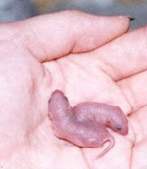
Reaction Range Example:
How does life stress affect development?
Murgatroyd (2009)
Separated MICE from mothers 3 hours a day for the first 10 days (a long time in mouse life)
Stress changed genetic coding for vasopressin, which helps control mood and behavior – brains had more receptors
“programmed” to produce higher levels of stress hormones in their adult lives
STRESS = EPIGENETIC TRIGGER

Slide 14

6. Development is gradual, and in bursts & pauses, not small-to-large.
Windows of Opportunity for each, but not all have “critical periods”
  SOCIAL EMOTIONAL
  MOTOR and SENSES
  THINKING
  LANGUAGE
  Adolescence –
    Sexual
    Complex cognitive
  Evidence for grey matter changes in ADULT learning
  (Lovden et al., 2013).
Notes:
SLC: Need to work on this slide Maturation is underlining all areas of development etc. Make the information more explicit

Slide 15
Synaptic Density
At Birth
6 Years Old
14 Years Old
Rethinking the Brain, Families and Work Institute, Rima Shore, 1997.
Notes:
Detailed analysis of the patterns of nerve connection that form from birth to age 14 have been carried out. This slide which comes from the work of Huttenlocher shows the connections amongst the neurons at birth is not intense but that by the age of 6 the connection density is considerable. By the age of 14, the connection pattern is still greater than at birth but is less intense. The weak pathways have been cut out. This process is referred to as the wiring and sculpting of the brain. The wiring of neurons in the brain is hugely influenced by stimulation and the use of these neuron pathways. Thus, as you age, pathways that are not intensely used will disappear (use it or lose it). What this evidence does show, is that the early period of life has a significant effect on the wiring and sculpting of the brain.

Slide 16
As the brain grows…neurons
PROLIFERATE
  increase in number
MIGRATE
  move to various regions of the brain
DIFFERENTIATE
  increase in size, complexity, and functioning.
SPONTANEOUS EXUBERANCE and
PRUNING
  Natural and beneficial, use it or lose it
  Parents are not in a race to stimulate the brain before it dies!
MYELINIZATION
Notes:
Classroom Topics for Lecture, Discussion, and Demonstration
Lecture Starter: Video Clips of Neuronal Development

Slide 17
01-003
Sensitive Periods for Brain Development Continue for Years
Sensing
Language
Pathways
Higher
(vision, hearing)
Cognitive Function
-6
-3
0
3
6
9
1
4
8
12
16
Months
Years
Conception
AGE
C. Nelson, in From Neurons to Neighborhoods, 2000.
Notes:
Nelson, at the University of Minnesota, has outlined the wiring (synapse formation) and sculpting of the brain in the early years in respect to the sensing pathways, language and cognition. This shows you that the sensing pathways develop before language and this develops before cognition. It is clear that the development of these pathways occurs in the early years of life and is dependent on experiences in utero and in the early years of development. A problem in the development of sensing pathways in early life will obviously influence language development and cognitive development, which follows the development of the sensing pathways.

Slide 18
Brain Development takes a long time, so learning and mastery do too.
Brain areas that take the LONGEST to develop and need the most environmental support are related to…
  Self-regulation
  Problem-solving
  Language/communication
  Social skills
Notes:
What? SLC: add picture from flickr

Slide 19
7. Early Experience is Usually Connected to Later Experience!
Complex Relationships
Nutrition and Development
Notes:
what or why

Slide 20
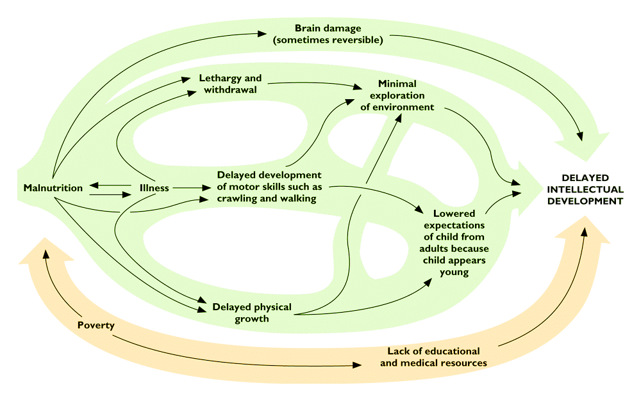
Systems Example: The Many Routes by Which Malnutrition Affects Development
From Brown and Pollitt, “Malnutrition, Poverty and Intellectual Development,” Scientific American, 274, (Feb. 1996), pp. 38-43.
Used by permission of Dimitry Schildlovsky.

Slide 21
Handal et al.
Ecuador Study (2007)
Studied 283 children 3 to 61 Months
Cayambe-Tabacundo region
Ages and Stages Questionnaire®, a simple interview with the parent, and observation of the children
88% listed primary language as Spanish
30% were delayed in gross motor skills
Children 48-61 months: 73% delayed in problem solving skills
60% anemia
53% stunting
Most (53%) were NOT low birth weight
A HIGH prevalence of developmental delay and poor growth in this region
BETTER RESULTS IF PARENT HAD MORE EDUCATION, A BETTER JOB, OR CHILD WAS STIMULATED INTELLECTUALLY AT A SCHOOL
Handal, Lozoff, Brielh, & Harlow (2007), Rev Pana Salud Publica

Slide 22
Hidden Milestones of Development based in the brain

Slide 23
Hidden Milestones of Development
SLEEP

Slide 24
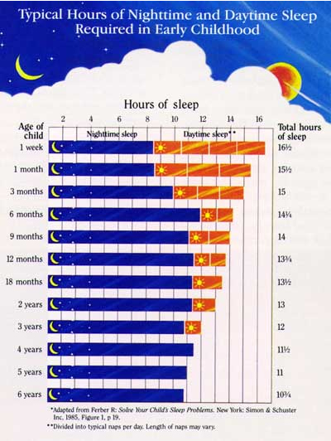
Some sleep patterns established in utero
Babies of depressed mothers may show “depression insomnia” patterns
Most baby sleep advice is bad or just wrong…be careful!

Slide 25
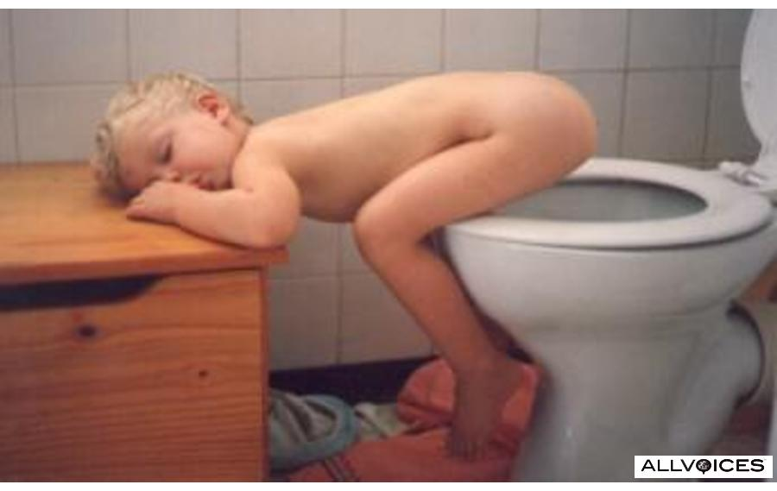
Sleep is Essential
These Sensory Systems Require REM (Rapid Eye Movement) Sleep
for Normal Development
1. Somatesthetic (Touch)
2. Kinesthetic (Motion)
3. Proprioception (Position)
4. Chemosensory (Smell and taste)
5. Auditory (Hearing)
6. Vision
7. Limbic (Emotion)
8. Social learning
9. Hippocampus (Memory)

Slide 26
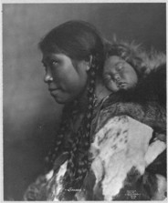
Sleep Milestones
Sleep is driven by brain development, not parenting practices, until about 6 months of age
Babies sleep when they are tired
“Management” of infant sleep seen as a mark of good or bad parenting – un-necessary stressor
Most newborns eat every 2-3 hours and sleep about that long
Most 3month olds occasionally sleep 5 hours at a stretch
Nearly all 6 month olds do so
This is not influenced much by parenting techniques
Co-sleeping is a cultural belief; does not need to be a health hazard, though it can be.

Slide 27
Hidden Milestones of Development
Hidden Milestones of Development
ACTIVITY LEVEL

Slide 28
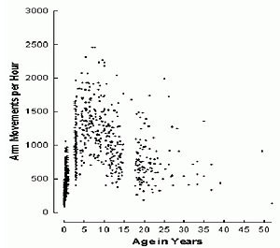
Activity Level and Attention
Activity level of 800+ people studied over time
Children steadily increase in activity level until about age 10, then drop off
0-3 is a VERY physically active time
We over-diagnose attention related problems in this period
Diagnosis of movement/attention related problems is very difficult before age 5
Most active child is usually a boy
The ability to pay attention develops at about the same rate
http://home.cc.umanitoba.ca/~eaton/developmental-trajectories.htm

Slide 29

TV and the Brain: News
From Pediatrics:
Fifty-nine percent of children younger than two years regularly watch an average of 1.3 hours of television per day, despite the fact that there is no programming of proven educational value for children this young.
Early TV is related to attention, activity level, and cognitive problems later on
American Academy of Pediatrics recommends: NO TV for children under 2
TURN IT OFF!
How young is too young?

Slide 30
Other Experiences that Build the Brain
Music and Language are Partners
  Deutsch, 2010
  Music fosters communication skills, memory development, executive function, social, and early reading skills
Hands-On: Touch, movement and gestures enhance critical thinking skills
Cabrera & Cotosi (2010)

Slide 31
The Good News!
The child’s brain develops just fine, if the environment is as it should be.
The Bad News? Many of our children don’t have adequate environments.

Slide 32
Neuro Myths
Caveat emptor

Slide 33
Imagine if…..
10% of brain used
Academically doomed without schooling before age 5
Brain shrinks if not 6-8 glasses of water per day
Left and right brained people are completely different
You can only learn through one “style”
One relationship determined your whole life path with no hope for the future
80% of your future was determined by age 5
Common myths about neuroscience
* Howard-Jones, P. Neuroscience and education: Myths and Messages. Nature Reviews Neuroscience, December 2014.

Slide 34
Summary
Good News: brain development is fine if environment is adequate.
Brain is self-righting.
Brain development begins at conception & keeps on going.
Early is Important. But so is later.
Brain development is not uniform or linear.
    synapses, transient exuberance, pruning, myelination, cognition in teens
Neurological development takes years, so learning and mastery do, too.
  Executive function and social-emotional development take the longest & need the most support.
Notes:
SLC portion Conclusionary slide: recap of first slides

Slide 35
More neuromyths
Past Ideas
What We Know in 2019
Humans use only 10% of their brains
Left Brain and Right Brain people are different
You can’t learn 2 languages simultaneously.
Boy and girl brains differ in ways that affect their learning
Each child has a particular learning style
The Myth of 3: first 3 years more important than next 3
Much recovery and retraining of the brain is possible, especially in children
We use all of our brains
Brain recruits from left and right for all major functions
Children learning 2 languages do not confuse them. They do learn each one a little more slowly.
We all learn better when information is presented in a variety of ways
Brain remains “plastic” through childhood

Slide 36
Early education and intervention are important, but the brain remains “plastic” throughout childhood.
2020: A more optimistic view.

