Slide 1
Literacy is a social justice issue
We must understand that

Slide 2
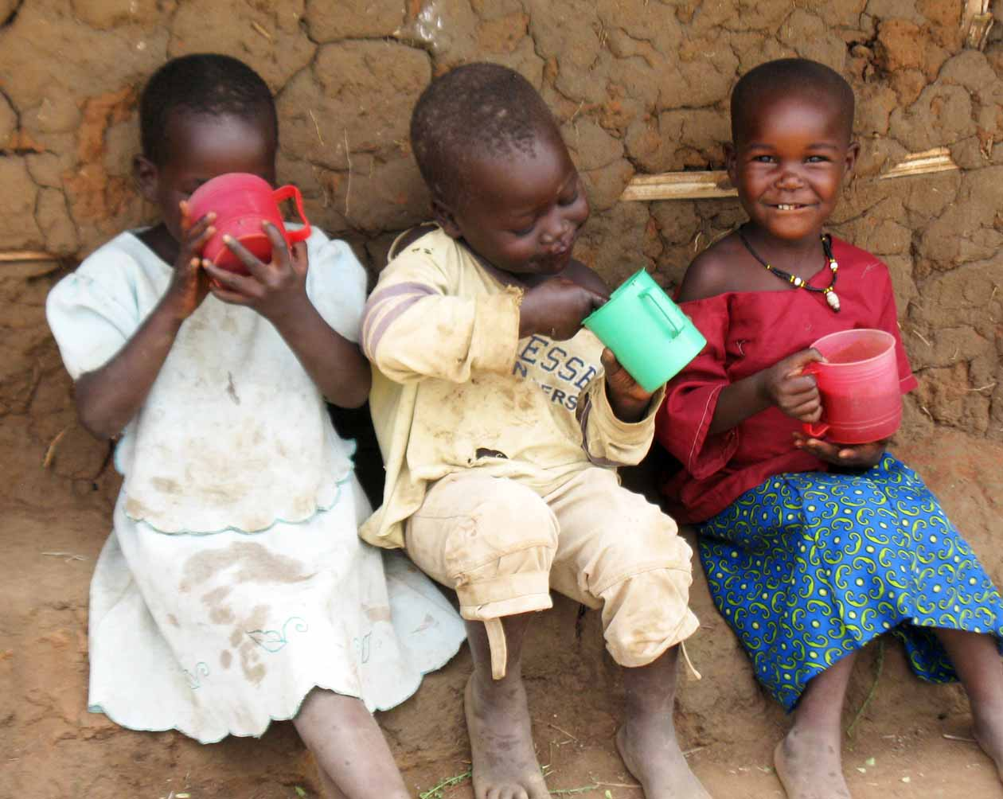

School Readiness in Context
Uganda, Lake Bunyoni
Rwanda, Teach Rwanda and school visits, Kigali, Duha, REAP

Slide 3
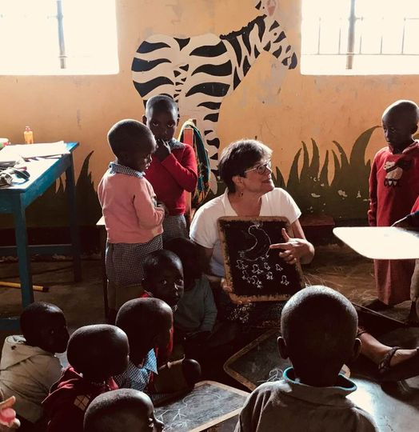
Sharon Carnahan, Ph.D.
Professor of Psychology
Exec. Dir., Rollins College
Hume House CDC
Children’s Defense Fund Fellow 2019
Global Livingston Institute Teaching Fellow
Kyabahinga School, Nursery

Slide 4

Schools
Dedicated teachers and trained administrators
Training for teachers minimal & hard to access
No funds for materials, reduced class sizes, or better teacher pay
Active learning in early education seldom seen in rural/pastoral areas
No plumbing, electricity, or Internet access

Slide 5
Early Education in Uganda
There is a Plan
Full access to Nursery and Preschool = Uganda and UN Millennial Goal
National plan in place for free, play-based, constructivist early education
National plan and curriculum meets best practice standards
BUT it’s not being done
Training for teachers minimal & hard to access
No funds for materials, reduced class sizes (40), or better teacher pay
Active learning in early education seldom seen in rural/pastoral areas
Not preparing for global:
  problem solving, competitive jobs, leadership

Slide 6
What Is The State of Lake Bunyoni’ s Children?
FIRST
We interviewed 57 educators at Kisiizi, Kyabahinga, Kifuka, Mugyera, All Saints Church Kindergarten, Murambo, Bwama, Katiba, and Bufuka Primary Schools. (Kate Knight, Bright Kiboniere)
NEXT
We revisited Kyabahinga, Kisiizi, Bufuka, Katiba, Bwama, Mugyera & Kifuka Primary Schools and did classroom observations (Sharon Carnahan, Bright Kiboniere)
FINALLY
We gathered with over 30 Headmasters, Teachers and Government and Church Leaders for a School Readiness Summit at Entusi Resort, Lake Bunyoni in February 2019
NEXT – interview study of the ECE curriculum

Slide 7
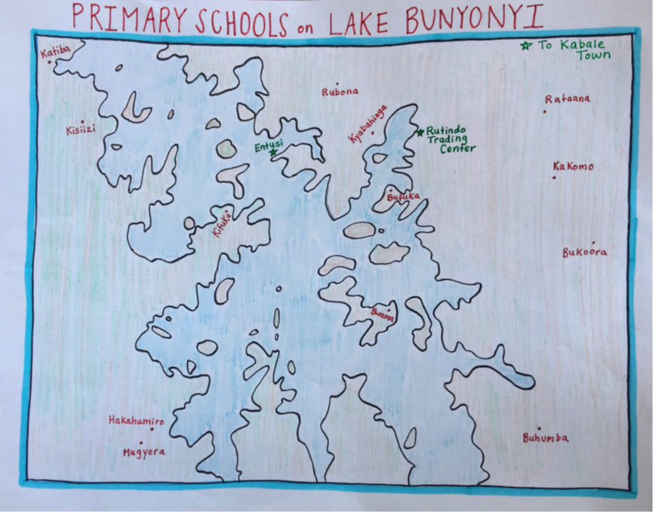

Slide 8
Goal:
All children will enter school ready to succeed & transform their country
Ready children
Ready teachers
Ready families
Ready schools

Slide 9
The children who canoe to school
https://www.bbc.com/news/av/world-africa-39589447

Slide 10
HOW? Listening to Leaders: Interviews
Teachers want resources & training
Parent Sensitization
Most parents are illiterate and communication is hard
Hardships caused by the remote locations include walking 5 kilometers to school, teachers needing to live at school without safe housing, no electricity
Hunger and malnutrition in pupils and sometimes teachers
Desire for more church support
Incomplete number of school books and no story or reading books
Exam fees charged by the District for weekly or monthly tests leave many children out of the education process, because they can’t afford tests or extra tutoring
Lack of knowledge of government policy action plan in ECD, or access to printed resources produced in Kampala.

Slide 11
One teacher said:
(Before school,) The parents teach the children to work very hard, to maintain their health, to speak their language, but other than that, not at all.
They are working and caring for other children.

Slide 12
Listening in Interviews

Slide 13
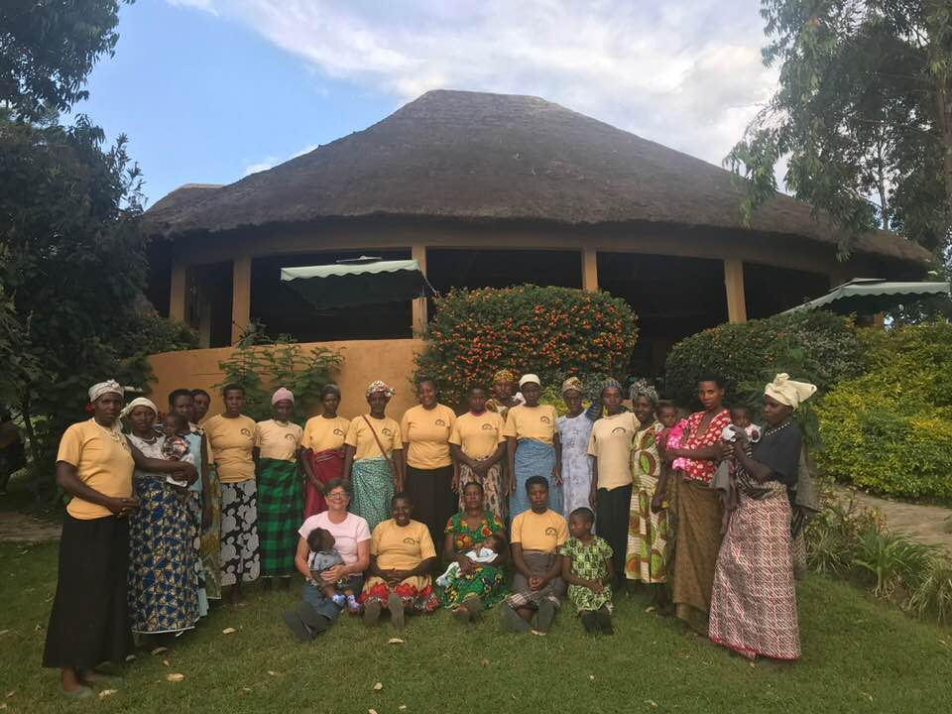
Listening to Entusi Women Society
(Topic: The First 1000 Days & Reproductive Choices)
I have 10 children.
Is it too late to help them?
How can I get contraception that my husband cannot see?

Slide 14
Strengths in Schools
•There are experienced, trained teachers in administrative positions in all of the schools.
•Each Headmaster identified excellent teachers on his staff.
•All follow the government-approved curriculum.
•Attendance is taken and tracked, and large numbers of children in attendance.
•The schools are staffed and open every day, although there are no provisions for substitutes, and children may spend a day without a teacher.
•There are radios at all schools.

Slide 15
Learning by Song, Repetition and Imitation
Song: Bend Down, Stand Up
We were going to our school in the morning
On the way we met some local children who could not attend school
But we convinced them to go to school because education is the future!
They agreed and joined us to school
So far they are doing well in class!

Slide 16
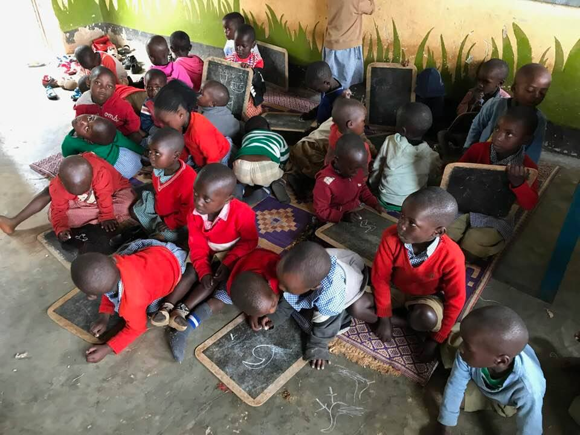
Preschool children copy a figure from a model onto slates

Slide 17
Summit on School Readiness
2019
Community Leaders & Teachers Created an Agenda
Uganda

Slide 18
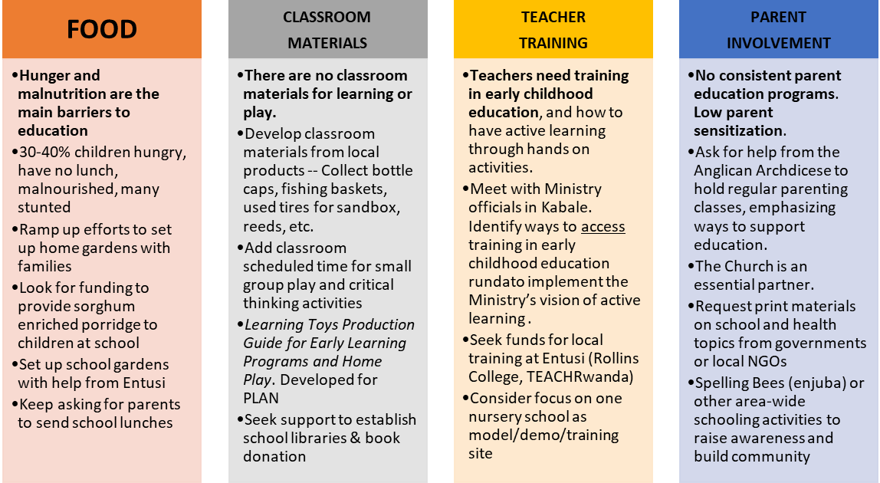

Slide 19
conclusion: priorities
Food and nutrition
Materials for Classrooms
Teacher Training
Access to local resources
Parent Sensitization (knowledge and involvement)
Electricity and internet

Slide 20
Strategic Plan?
Demonstration schools
A little for each
Choose 3
Add training
Raise excitement not resources
Spelling Bee
  Fun
  Reading
  Get into school
Teacher PAY
Train all
Look for $
How do you penetrate a school system?

Slide 21
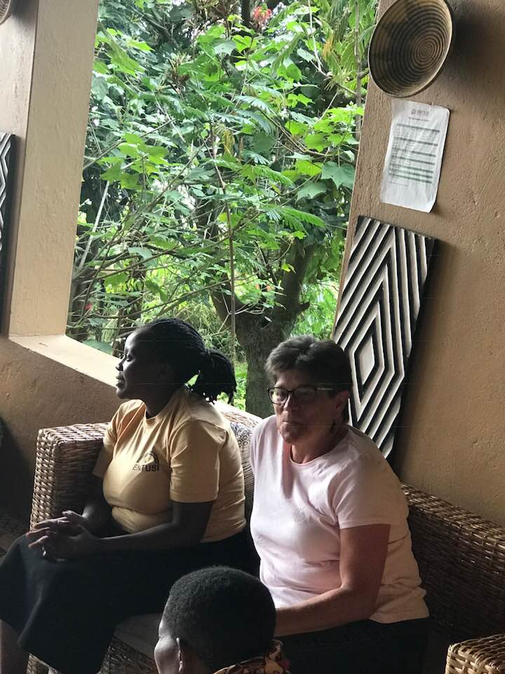
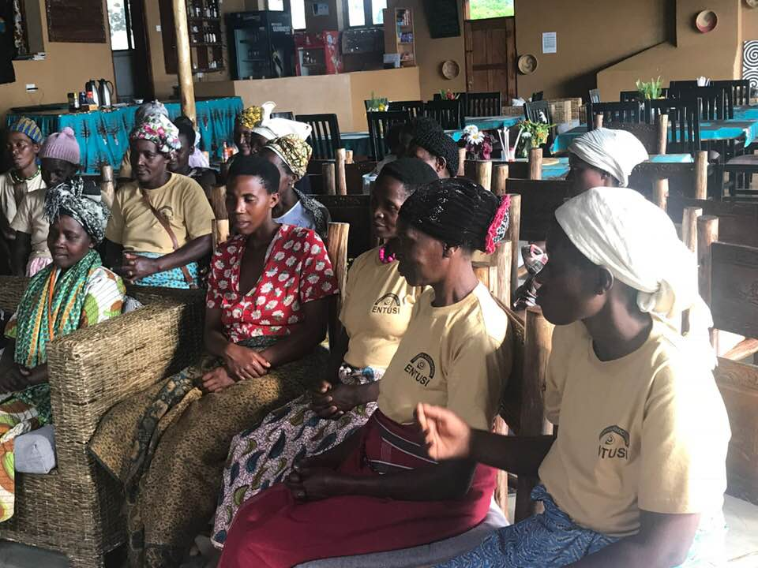
Thank You

